Slide 1
HOLOGRAPHIC GRADIENTS CONSULTING TOOLKIT
HOLOGRAPHIC
GRADIENTS
Here is where your presentation begins

Slide 2
CONTENTS OF THIS TEMPLATE
Here’s what you’ll find in this Slidesgo template:
A slide structure based on a consulting presentation, which you can easily adapt to your needs. For more info on how to edit the template, please visit Slidesgo School or read our FAQs.
An assortment of graphic resources that are suitable for use in the presentation can be found in the alternative resources slide.
A thanks slide, which you must keep so that proper credits for our design are given.
A resources slide, where you’ll find links to all the elements used in the template.
Instructions for use.
Final slides with:
The fonts and colors used in the template.
A selection of illustrations. You can also customize and animate them as you wish with the online editor. Visit Storyset to find more.
More infographic resources, whose size and color can be edited.
Sets of customizable icons of the following themes: general, business, avatar, creative process, education, help & support, medical, nature, performing arts, SEO & marketing, and teamwork.
You can delete this slide when you’re done editing the presentation.

Slide 3
TEMPLATE WITH WORDARTS
This is WordArt text. If you want to modify it:
Double click on it
Type your new text in the dialog box
You can change the fill color in the top menu
You can also modify the stroke, its color, thickness or type
Press Enter
WHOA!

Slide 4
TABLE OF CONTENTS
1
2
3
4
PROJECT & STRATEGY DEFINITION
You could describe the topic of the section here
CONSULTING PROPOSAL
You could describe the topic of the section here
CHANGE MGMT & PROJECT MGMT
You could describe the topic of the section here
IMPLEMENTING CHANGES
You could describe the topic of the section here

Slide 5
—SOMEONE FAMOUS
“This is a quote. Words full of wisdom that someone important said and can make the reader get inspired”

Slide 6
1
PROJECT STRATEGY & DEFINITION
You could enter a subtitle here if you need it

Slide 7

OUR COMPANY
OUR
COMPANY
Despite being red, Mars is actually a cold place. It's full of iron oxide dust, which gives the planet its reddish cast

Slide 8
PROJECT DEFINITION & STRATEGIC PLAN
Do you know what helps you make your point clear? Lists like this one:
They’re simple
You can organize your ideas clearly
You’ll never forget to buy milk!
And the most important thing: the audience won’t miss the point of your presentation

Slide 9
DEFINE AND EXECUTE THE BUSINESS STRATEGY
MERCURY
Mercury is the closest planet to the Sun and the smallest one in the Solar System
VENUS
Venus has a beautiful name and is the second planet from the Sun. It’s terribly hot

Slide 10
TIMELINE OF ANNUAL PROFITABLE GROWTH
2023
2022
2021
2020
REPORT
TEST
ADAPT
It’s the farthest from the Sun
PLAN
Jupiter is the biggest planet
Mars is a very cold place
Venus has a lovely name

Slide 11
STRATEGIC PLANNING OF GOALS
 | WEEK | 1 | 2 | 3 | 4 | 5 | 6 | 7
1 | Key strategic objectives
2 | Create strategy map
3 | Identify objectives
4 | Getting the first report
Workshop 1
Workshop 2
Workshop 2
Workshop 3

Slide 12
STRATEGIC PLAN OF THE TEAM
A
B
C
LEADERSHIP TEAM
Despite being red, Mars is actually a cold place. It's full of iron oxide dust
CORE TEAM
Venus has a beautiful name and is the second planet from the Sun. It’s terribly hot
MEASUREMENT TEAM
Mercury is the closest planet to the Sun and the smallest one in the Solar System

Slide 13
MISSION STATEMENT & VISION STATEMENT
MISSION DESCRIPTION
VISION DESCRIPTION
Write your mission here
Write your mission here
Write your mission here
Write your mission here
Write your mission here
Write your vision here
Write your vision here
Write your vision here
Write your vision here
Write your vision here

Slide 14
PERSPECTIVES & STRATEGIC OBJECTIVES
FINANCIAL PROJECTS | Mercury is the smallest planet | It’s the closest to the Sun | 57,910,000 km far from the Sun
CUSTOMER SERVICES | Venus has a beautiful name | It’s terribly hot, more than Mercury | 108,200,000 km far from the Sun
INTERNAL PROCESS | Mars is actually a very cold place | It's full of iron oxide dust | 227,900,000 km far from the Sun
LEARNING & GROWTH | Neptune is the farthest planet | It's the fourth largest object | 4,504,300,000 km far from the Sun

Slide 15
BALANCED SCORECARD IN FOUR STEPS
Mercury is the closest planet to the Sun and the smallest one in the Solar System | FINANCIAL PROJECTS | CUSTOMER SERVICES | Earth is the third planet from the Sun and the only one that harbors life in the Solar System
Venus has a beautiful name and is the second planet from the Sun. It’s terribly hot | INTERNAL PROCESS | LEARNING & GROWTH | Neptune is the farthest planet. It's also the fourth largest object by diameter of all

Slide 16
ABOUT THE ANSOFF MATRIX
VENUS
MARS
MERCURY
JUPITER
Venus is the second planet from the Sun
Despite being red, Mars is a very cold place
Mercury is the closest planet to the Sun
It’s the biggest planet in the Solar System

Slide 17
ANALYZE YOUR MANAGEMENT OPTIONS
MARKET DEVELOPMENT | DIVERSIFICATION
This planet's name has nothing to do with the liquid metal, since Mercury was named after the Roman messenger god | Venus has a beautiful name. It’s terribly hot, even hotter than Mercury, and its atmosphere is extremely poisonous
MARKET PENETRATION | PRODUCT DEVELOPMENT
Saturn is a gas giant and has several rings. It was named after the Roman god of wealth and agriculture | Jupiter is a gas giant and the biggest planet. It was named after the Roman god of the skies and lightning

Slide 18
USE A NINE-BOX ANSOFF MATRIX
MARKET DEVELOPMENT | PARTIAL DIVERSIFICATION | DIVERSIFICATION
MARKET EXPANSION | LIMITED DIVERSIFICATION | PARTIAL DIVERSIFICATION
MARKET PENETRATION | PRODUCT EXTENSION | PRODUCT DEVELOPMENT
New
MARKETS
Expanded
Current
Current
Modified
New
PRODUCTS AND SERVICES

Slide 19
ABOUT PORTER'S GENERIC STRATEGIES
1
2
3
4
5
6
MERCURY
VENUS
MARS
Mercury is the closest planet to the Sun
Venus is the second planet from the Sun
Despite being red, Mars is a cold place
JUPITER
SATURN
NEPTUNE
Jupiter is the biggest planet of them all
It’s composed of hydrogen and helium
It’s the farthest planet from the Sun

Slide 20
THE LEADERSHIP & FOCUS STRATEGY
1
2
3
4
1 COST LEADERSHIP | 3 DIFFERENTIATION LEADERSHIP
2 COST FOCUS | 4 DIFFERENTIATION FOCUS
Mercury is the smallest planet
Broad
Mars is a very cold place
SCOPE
Narrow
Jupiter is a gas giant planet
Cost
Differentiation
Neptune is the farthest planet
SOURCE OF COMPETITIVE ADVANTAGE

Slide 21
KEY DRIVERS OF THE PROFIT
 | DESCRIPTION | EXAMPLE
SITUATION | Mercury is the closest planet to the Sun and the smallest one | Earth is the third planet from the Sun and the only that harbors life
COMPLICATION | Venus has a beautiful name and is the second planet from the Sun | Despite being red, Mars is actually a cold place. It's full of iron oxide dust
QUESTION | Saturn is a gas giant and has rings. It’s composed mostly of hydrogen | Jupiter is the biggest planet and one of the four gas giants

Slide 22
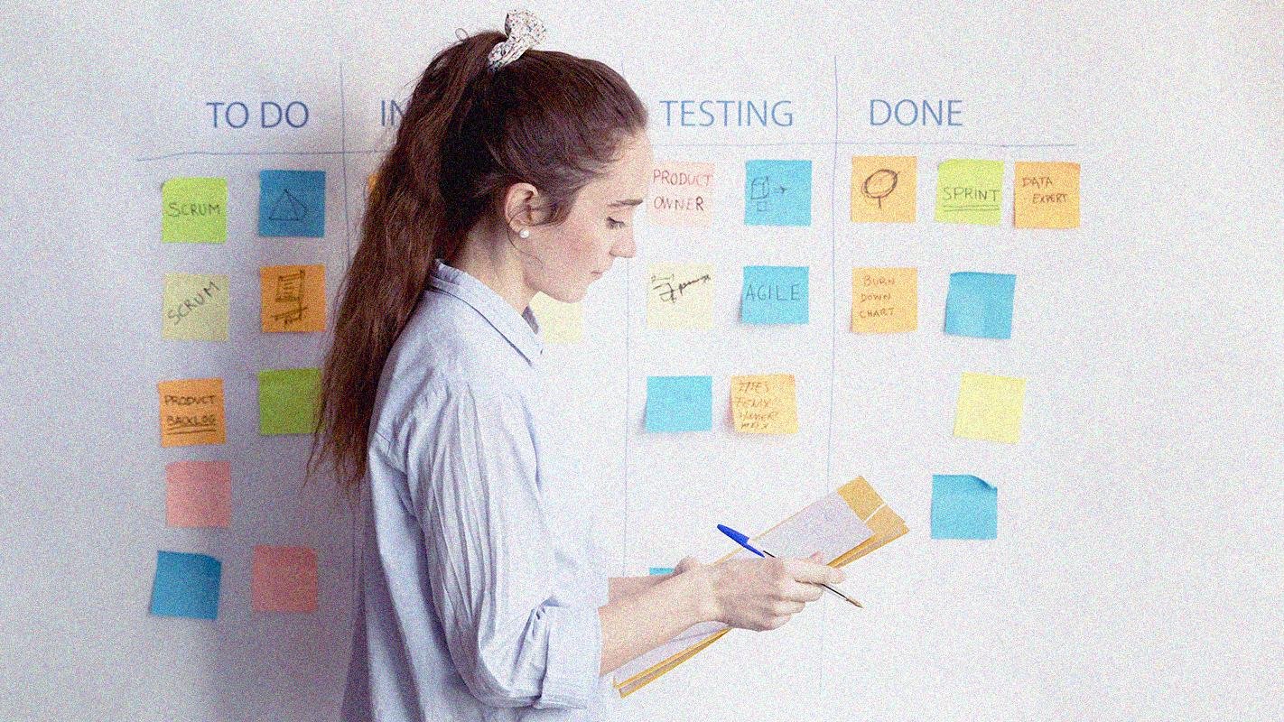
A PICTURE ALWAYS REINFORCES THE CONCEPT
Images reveal large amounts of data, so remember: use an image instead of a long text. Your audience will appreciate that

Slide 23
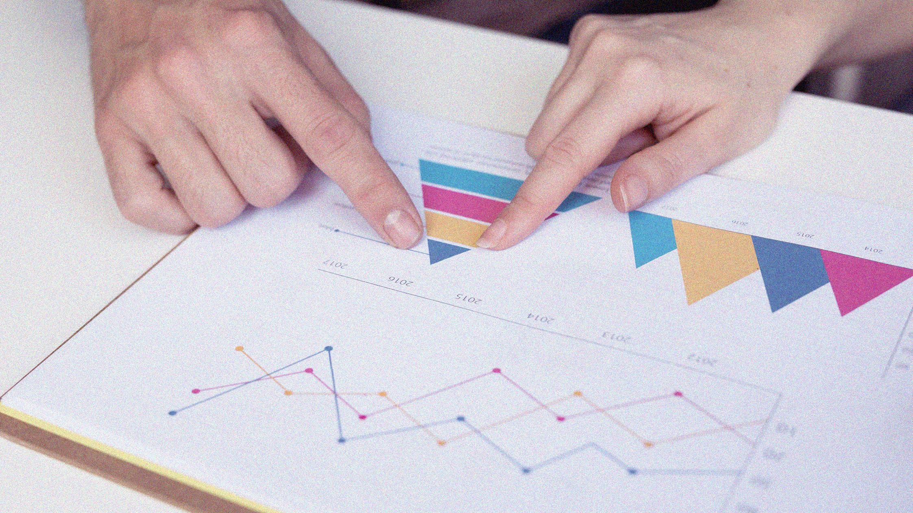
A PICTURE IS WORTH A THOUSAND WORDS

Slide 24
AWESOME WORDS
AWESOME
WORDS

Slide 25
PROBLEMS OF A NEW MARKET
PROFIT PROBLEM
MARKET PROBLEM
PRODUCT PROBLEM
M&A PROBLEM
Mercury is the closest planet to the Sun
Venus is the second planet from the Sun
Jupiter is the biggest planet of them all
Neptune is the farthest planet from the Sun

Slide 26
4 STEPS OF THE NEW PRODUCT & MARKET
1
2
3
4
1
2
3
DESIRABILITY
Mercury is the smallest planet
PROFITABILITY
Mars is actually a cold place
FEASIBILITY
Neptune is the farthest planet
4
SWEET SPOT
Venus has a beautiful name

Slide 27
NEW PRODUCT DESIRABILITY CHART
40%
30%
20%
10%
EXPERIENCE
UTILITY
Mercury is the smallest planet
Jupiter is a gas giant planet
USABILITY
DESIRE
Mars is actually a very cold place
Neptune is the farthest planet

Slide 28
TOP 10 QUESTIONS OF BUSINESS PLANS
1
6
2
7
3
8
4
9
5
10
Jupiter is a gas giant and the biggest planet of them all
It was named after the Roman god of the lightning
Saturn is a gas giant and has several rings around it
It was named after the Roman god of agriculture
It’s the closest planet to the Sun and the smallest one
This planet's name has nothing to do with the metal
It has a nice name and is the second planet from the Sun
Venus is terribly hot and its atmosphere is poisonous
Despite its red surface, Mars
is actually a very cold place
It's full of iron oxide dust, which gives its reddish cast

Slide 29
COMPETITOR COMPARISON TABLE
ATTRIBUTES | COMPETITOR A | COMPETITOR B | MY BUSINESS
PRICE | $200 | $230 | $190
QUALITY | Low | Medium | High
CUSTOMER | 3,500 | 2,400 | 4,200
REPUTATION | Average | Bad | Good
LOCATION | China | Chile | USA

Slide 30
LOCATION COMPARISON MAP
55%
20%
15%
CHINA
It’s the biggest planet
USA
Mars is a cold place
CHILE
Saturn is a gas giant

Slide 31
STRONG BUSINESS CASE
PROJECT NAME | Solar System Project
AUTHOR | Saturn, Mercury and Jupiter
PROJECT SPONSOR | Earth, Sun and Moon
PROJECT MANAGER | James Franklin
CHANGE MANAGER | Anna Costa
DATE | July, 2021
STATUS | Running
YOUR LOGO
Here you can insert your own logo

Slide 32
FINANCIAL TECHNIQUES AND STRATEGIES
VALUING A BUSINESS OR ASSET
COST APPROACH
MARKET APPROACH
CASH FLOW
Mercury is the closest planet to the Sun
Despite being red, Mars is actually a cold place
Saturn is a gas giant. It's composed of hydrogen
Venus has a nice name, but it’s very hot
It was named after the Roman god of the skies
Neptune is the farthest planet from the Sun

Slide 33

CASH FLOW STATEMENT CHART
20%
35%
30%
15%
MERCURY
JUPITER
Mercury is the smallest planet
Jupiter is a gas giant planet
MARS
2015
2020
2025
2030
NEPTUNE
* To modify this graph, click on it, follow the link, change the data and paste the new graph here, replacing this one
Mars is actually a very cold place
Neptune is the farthest planet

Slide 34
COMPARATIVE PRICE MATURITY MODEL
1
2
3
30%
50%
70%
BASIC
STANDARD
ADVANCED
Mars is actually a very cold place
Mercury is the smallest planet
Jupiter is a gas giant planet

Slide 35
$300
$250
$600
Mercury is the smallest planet in the Solar System
Venus has a beautiful name, but it’s terribly hot
Despite being red, Mars is actually a very cold place

Slide 36
$4.300,00
$4,300.00
Big numbers catch your audience’s attention

Slide 37
2
CONSULTING PROPOSAL
You could enter a subtitle here if you need it

Slide 38

ABOUT THE TERMS OF THE AGREEMENT
30%
10%
20%
10%
15%
15%
SERVICES
MATERIALS
Jupiter is a gas giant
Earth harbors life
FEES
TERMS
Venus is terribly hot
Mars is a cold place
* To modify this graph, click on it, follow the link, change the data and paste the new graph here, replacing this one
EXPENSES
WARRANTIES
Mercury is small
Saturn is a gas giant

Slide 39
POSSIBLE ANSWERS AND ARGUMENTS
WRITE YOUR QUESTION
WRITE YOUR ANSWER
SATURN
VENUS
EARTH
Saturn is a gas giant and has several rings. It's composed mostly of hydrogen and helium
Venus has a beautiful name and is the second planet from the Sun. It’s terribly hot
Earth is the third planet from the Sun and the only one that harbors life in the Solar System

Slide 40
INITIATIVE PRIORITIZATION MATRIX
 | INITIATIVE NAME | IMPACT | EFFORT
1 | JUPITER AND SATURN INITIATIVE NAME | Jupiter is a gas giant and the biggest planet | Saturn is a gas giant and has several rings
2 | NEPTUNE AND MERCURY INITIATIVE NAME | Neptune is the farthest planet from the Sun | Mercury is the closest planet to the Sun
3 | VENUS AND MARS INITIATIVE NAME | Venus is the second planet from the Sun | Despite being red, Mars is actually a cold place

Slide 41
IMPACT & EFFORT: PRIORITIZATION MATRIX
LONGER TERM | PRIORITIZED
Mercury is the closest planet to the Sun and the smallest one | Venus has a beautiful name and is the second planet from the Sun
UNATTRACTIVE | LOW VALUE
Despite being red, Mars is actually a cold place. It's full of iron oxide dust | Jupiter is a gas giant and the biggest planet in the Solar System
High
IMPACT
Low
High
Low
EFFORT

Slide 42
3
CHANGE MANAGEMENT & PROJECT MANAGEMENT
You could enter a subtitle here if you need it

Slide 43
WATERFALL MANAGEMENT PLAN
REQUIREMENTS
Jupiter is a gas giant and the biggest planet of all
DESIGN
Despite being red, Mars is a cold place full of iron dust
IMPLEMENTATION
Venus has a nice name, but it’s terribly hot
VERIFICATION
Mercury is the closest planet to the Sun and the smallest
MAINTENANCE
Saturn is a gas giant and has several rings

Slide 44
EXECUTIVE AND CORPORATE SUMMARY
PROBLEM & SOLUTION | It was named after the Roman god of the skies | MISSION & VISION | It's the fourth brightest object in the night sky
MARKET ANALYSIS | Saturn is a gas giant planet and has several rings | STRATEGIC OBJECTIVES | It's composed mostly of hydrogen and helium
CUSTOMER SEGMENTS | Venus has a lovely name, but it’s terribly hot | MARKETING PLAN | It's the fourth-largest object by diameter
BUSINESS STRUCTURE | This planet's name has nothing to do with the metal | FINANCIAL PLAN | Despite being red, Mars is actually a cold place

Slide 45
IMPACT ASSESSMENT MATRIX IN THE TEAM
 | TEAM | DEPT. | BUSINESS | COMPANY
High | Mercury | Neptune | Saturn | Saturn
Medium | Mercury | Neptune | Neptune | Saturn
Moderate | Venus | Mercury | Neptune | Neptune
Low | Venus | Venus | Mercury | Neptune
COMPLEXITY
DIMENSION

Slide 46
4
IMPLEMENTING CHANGES
You could enter a subtitle here if you need it

Slide 47
ABOUT LEAN SIX SIGMA TOOLS
MONITOR
CATEGORIZE
Despite being red, Mars is actually a cold place
Jupiter is a gas giant and the biggest planet
AUTHORIZE
SELECT
Venus has a beautiful name, but it’s very hot
Saturn is a gas giant and has several rings
ASSESS
IMPLEMENT
Mercury is the closest planet to the Sun
Neptune is the farthest planet from the Sun

Slide 48
STRATEGY & SALES
IMPLEMENTATION PLAN
 | INTERNAL ANALYSIS | Mercury is the closest planet to the Sun and the smallest one
 | EXTERNAL ANALYSIS | Venus has a beautiful name and is the second planet from the Sun
 | SALES STRATEGY | Earth is the third planet from the Sun and the only that harbors life
 | SALES PLAN | Jupiter is a gas giant and the biggest planet of them all
 | IMPLEMENTATION | It's the fourth-largest object by diameter in the Solar System

Slide 49
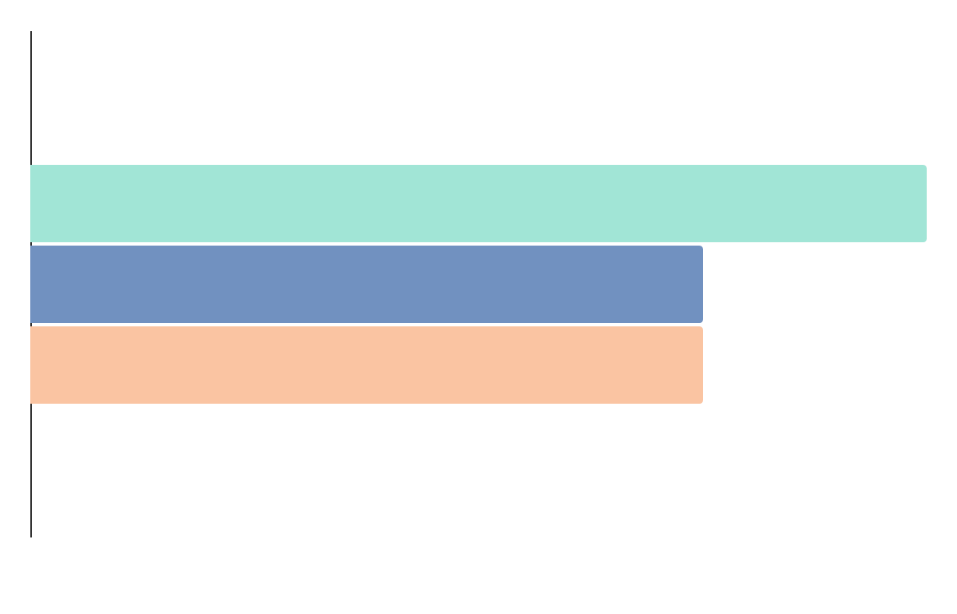
SALES TRACKING PERCENTAGE CHART
40%
30%
30%
VENUS
It has a nice name
MARS
Mars is a cold place
SATURN
* To modify this graph, click on it, follow the link, change the data and paste the new graph here, replacing this one
Saturn is a gas giant

Slide 50
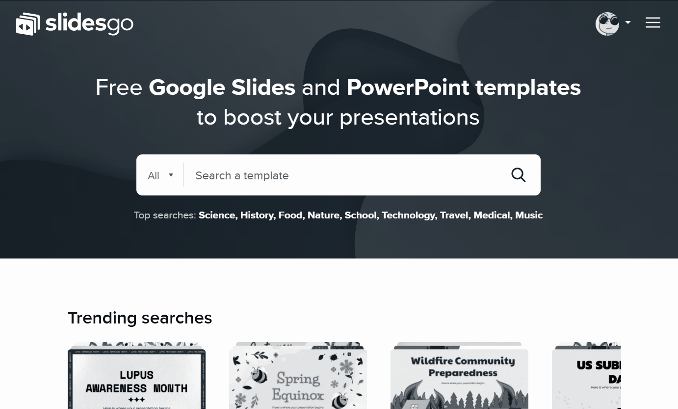
DEMO SOFTWARE & APPLICATION
You can replace the image on the screen with your own work. Right-click on it and then choose "Replace image" (in Google Slides) or "Change Picture" (in PPT) so you can add yours

Slide 51

YOUR TEAM OF SPECIAL ADVISERS
MARTHA LOPES
Here you can talk a bit about this person
GREG DOE
Here you can talk a bit about this person

Slide 52
THANKS!
THANKS!
Do you have any questions?
youremail@freepik.com
+91 620 421 838
yourcompany.com
Please keep this slide for attribution

Slide 53
ALTERNATIVE RESOURCES
Here’s an assortment of alternatives resources within the same style of this template
GRADIENTS
Holographic cards set
Memphis holographic card collection
Abstract holographic cards
Pack four holographic cards
Modern holographic cards
PHOTOS
Close up sticky note with product backlog
Close up adult man working
Man preparing business plan
Close up business analysis table
Colleagues planning business project
Woman planning business method

Slide 54
RESOURCES
Did you like the resources? Get them for free at our other websites.
GRADIENTS
Multicolor holographic cards
Holographic cards pack
PHOTOS
Bearded man working laptop
Adult woman planning project office
Close up colleagues analysing business chart
Couple with arms crossed

Slide 55
Instructions for use (free users)
In order to use this template, you must credit Slidesgo by keeping the Thanks slide.
You are allowed to:
Modify this template.
Use it for both personal and commercial purposes.
You are not allowed to:
Sublicense, sell or rent any of Slidesgo Content (or a modified version of Slidesgo Content).
Distribute this Slidesgo Template (or a modified version of this Slidesgo Template) or include it in a database or in any other product or service that offers downloadable images, icons or presentations that may be subject to distribution or resale.
Use any of the elements that are part of this Slidesgo Template in an isolated and separated way from this Template.
Delete the “Thanks” or “Credits” slide.
Register any of the elements that are part of this template as a trademark or logo, or register it as a work in an intellectual property registry or similar.
For more information about editing slides, please read our FAQs or visit Slidesgo School:
https://slidesgo.com/faqs and https://slidesgo.com/slidesgo-school

Slide 56
Instructions for use (premium users)
In order to use this template, you must be a Premium user on Slidesgo.
You are allowed to:
Modify this template.
Use it for both personal and commercial purposes.
Hide or delete the “Thanks” slide and the mention to Slidesgo in the credits.
Share this template in an editable format with people who are not part of your team.
You are not allowed to:
Sublicense, sell or rent this Slidesgo Template (or a modified version of this Slidesgo Template).
Distribute this Slidesgo Template (or a modified version of this Slidesgo Template) or include it in a database or in any other product or service that offers downloadable images, icons or presentations that may be subject to distribution or resale.
Use any of the elements that are part of this Slidesgo Template in an isolated and separated way from this Template.
Register any of the elements that are part of this template as a trademark or logo, or register it as a work in an intellectual property registry or similar.
For more information about editing slides, please read our FAQs or visit Slidesgo School:
https://slidesgo.com/faqs and https://slidesgo.com/slidesgo-school

Slide 57
Fonts & colors used
This presentation has been made using the following fonts:
Libre Franklin
(https://fonts.google.com/specimen/Libre+Franklin)
#182026
#fac4a2
#fff393
#a1e5d6
#6ce0d3
#7191c0
#c190bf

Slide 58





Storyset
Create your Story with our illustrated concepts. Choose the style you like the most, edit its colors, pick the background and layers you want to show and bring them to life with the animator panel! It will boost your presentation. Check out How it Works.
Pana
Amico
Bro
Rafiki
Cuate

Slide 59
Use our editable graphic resources...
You can easily resize these resources without losing quality. To change the color, just ungroup the resource and click on the object you want to change. Then, click on the paint bucket and select the color you want. Group the resource again when you’re done. You can also look for more infographics on Slidesgo.

Slide 62
JANUARY
FEBRUARY
MARCH
APRIL
MAY
JUNE
PHASE 1
Task 1
Task 2
PHASE 2
Task 1
Task 2
JANUARY
FEBRUARY
MARCH
APRIL
PHASE 1
Task 1
Task 2

Slide 65
...and our sets of editable icons
You can resize these icons without losing quality.
You can change the stroke and fill color; just select the icon and click on the paint bucket/pen.
In Google Slides, you can also use Flaticon’s extension, allowing you to customize and add even more icons.

Slide 66
Educational Icons
Medical Icons

Slide 67
Business Icons
Teamwork Icons

Slide 68
Help & Support Icons
Avatar Icons

Slide 69
Creative Process Icons
Performing Arts Icons

Slide 70
Nature Icons

Slide 71
SEO & Marketing Icons

Slide 72


